Slide 1
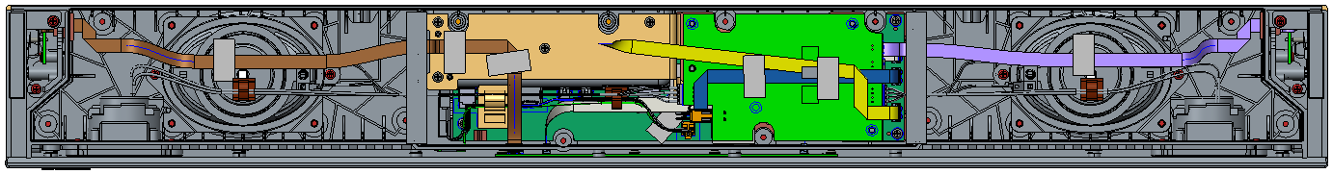
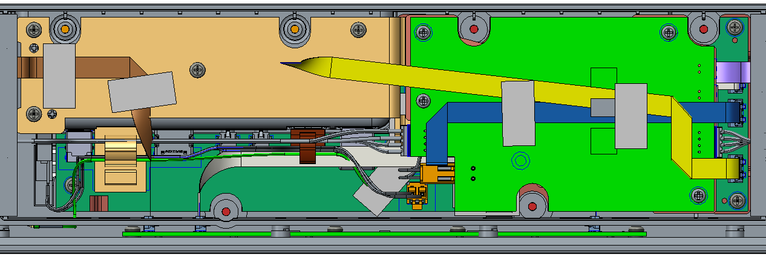
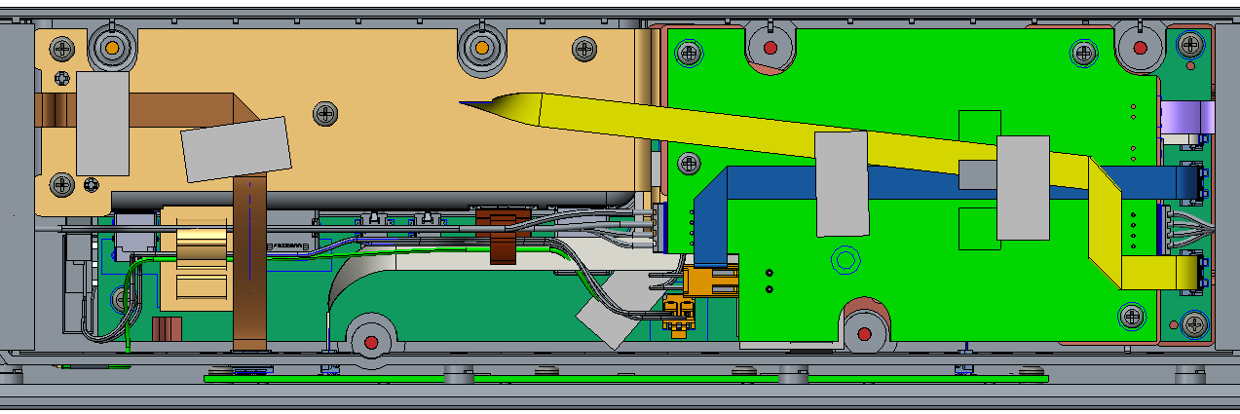
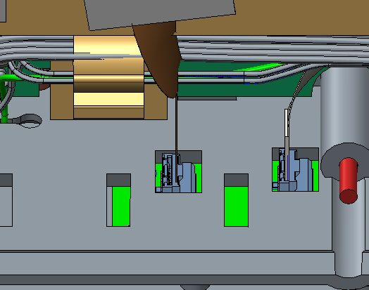
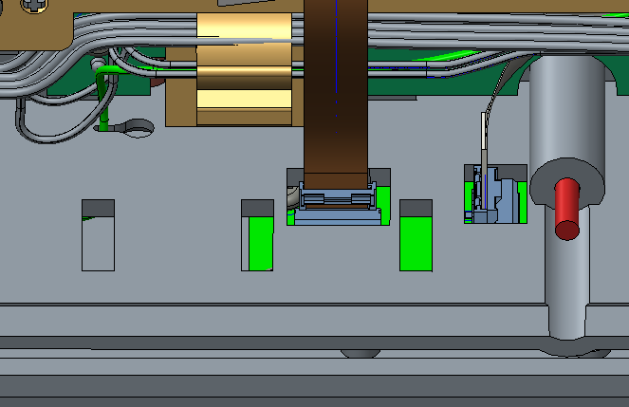
FFC cable for Left side LED board and LED board:
According to the previous assembly, the FFC cable is easy to fall off, so we need to turn the connector to 90 degrees. And the hole on the bottom cover need to be modified.

